Slide 1
Lecture 10-12
Data Structures
Presented By:
Marina Gul

Slide 2
Topics to be covered
Recap of the previous lecture
Queue

Slide 3
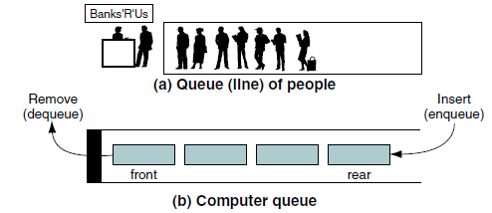
Queue
First in–first out (FIFO) structure
Insertion from one end called rear and deletion from another end called front
Real world examples
A line of people waiting for a bus at a bus station
A list of calls put on hold to be answered by a telephone operator
A list of waiting jobs to be processed
A list of documents to be printed by a printer

Slide 4
Basic Operations
Enqueue(Data): Data can be inserted at the rear end
Dequeue(): Data can be removed and returns from the front end (least recently-added data)
Boolean Empty(): are there any elements?
Queues are different from stacks as we need to track the front and the rear of the queue, whereas the stack only needs to worry about one end: the top

Slide 5
Queue Implementation with Linked List
head
tail

Slide 6
Queue Implementation with Linked List
head
tail
Enqueue(a)

Slide 7
Queue Implementation with Linked List
head
tail
a
Enqueue(a)

Slide 8
Queue Implementation with Linked List
head
tail
a

Slide 9
Queue Implementation with Linked List
head
tail
a
Enqueue(b)

Slide 10
Queue Implementation with Linked List
head
tail
a
b
Enqueue(b)

Slide 11
Queue Implementation with Linked List
head
tail
a
b

Slide 12
Queue Implementation with Linked List
head
tail
a
b
Empty()

Slide 13
Queue Implementation with Linked List
head
tail
a
b
Empty()→ False

Slide 14
Queue Implementation with Linked List
head
tail
a
b

Slide 15
Queue Implementation with Linked List
head
tail
a
b
Enqueue(c)

Slide 16
Queue Implementation with Linked List
head
tail
a
b
c
Enqueue(c)

Slide 17
Queue Implementation with Linked List
head
tail
a
b
c

Slide 18
Queue Implementation with Linked List
head
tail
a
b
c
Dequeue()

Slide 19
Queue Implementation with Linked List
head
tail
b
c
Dequeue()→ a

Slide 20
Queue Implementation with Linked List
head
tail
b
c

Slide 21
Queue Implementation with Linked List
head
tail
b
c
Enqueue(d)

Slide 22
Queue Implementation with Linked List
head
tail
b
c
d
Enqueue(d)

Slide 23
Queue Implementation with Linked List
head
tail
b
c
d

Slide 24
Queue Implementation with Linked List
head
tail
b
c
d
Enqueue(e)

Slide 25
Queue Implementation with Linked List
head
tail
b
c
d
e
Enqueue(e)

Slide 26
Queue Implementation with Linked List
head
tail
b
c
d
e

Slide 27
Queue Implementation with Linked List
head
tail
b
c
d
e
Enqueue(f)

Slide 28
Queue Implementation with Linked List
head
tail
b
c
d
e
f
Enqueue(f)

Slide 29
Queue Implementation with Linked List
head
tail
b
c
d
e
f

Slide 30
Queue Implementation with Linked List
head
tail
b
c
d
e
f
Dequeue()

Slide 31
Queue Implementation with Linked List
head
tail
b
c
d
e
f
Dequeue()→ b

Slide 32
Queue Implementation with Linked List
head
tail
c
d
e
f

Slide 33
Queue Implementation with Linked List
head
tail
c
d
e
f
Dequeue()

Slide 34
Queue Implementation with Linked List
head
tail
d
e
f
Dequeue()→ c

Slide 35
Queue Implementation with Linked List
head
tail
d
e
f

Slide 36
Queue Implementation with Linked List
head
tail
d
e
f
Dequeue()

Slide 37
Queue Implementation with Linked List
head
tail
e
f
Dequeue()→ d

Slide 38
Queue Implementation with Linked List
head
tail
e
f

Slide 39
Queue Implementation with Linked List
head
tail
e
f
Dequeue()

Slide 40
Queue Implementation with Linked List
head
tail
f
Dequeue()→ e

Slide 41
Queue Implementation with Linked List
head
tail
f

Slide 42
Queue Implementation with Linked List
head
tail
f
Dequeue()

Slide 43
Queue Implementation with Linked List
head
tail
Dequeue()→ f

Slide 44
Queue Implementation with Linked List
head
tail

Slide 45
Queue Implementation with Linked List
head
tail
Empty()

Slide 46
Queue Implementation with Linked List
head
tail
Empty() → True

Slide 47
Queue Implementation with Linked List
head
tail

Slide 48
Queue Implementation with Linked List
Enqueue: use List.PushBack
Dequeue: use List.TopFront and List.PopFront
Empty: use List.Empty

Slide 49
Queue Implementation with Array
0
read
0
write

Slide 50
Queue Implementation with Array
0
read
0
write
Enqueue(a)

Slide 51
Queue Implementation with Array
0
read
1
write
a
Enqueue(a)

Slide 52
Queue Implementation with Array
0
read
1
write
a

Slide 53
Queue Implementation with Array
0
read
1
write
a
Enqueue(b)

Slide 54
Queue Implementation with Array
0
read
2
write
a | b
Enqueue(b)

Slide 55
Queue Implementation with Array
0
read
2
write
a | b

Slide 56
Queue Implementation with Array
0
read
2
write
a | b
Empty()

Slide 57
Queue Implementation with Array
0
read
2
write
a | b
Empty()→ False

Slide 58
Queue Implementation with Array
0
read
2
write
a | b

Slide 59
Queue Implementation with Array
0
read
2
write
a | b
Enqueue(c)

Slide 60
Queue Implementation with Array
0
read
3
write
a | b | c
Enqueue(c)

Slide 61
Queue Implementation with Array
0
read
3
write
a | b | c

Slide 62
Queue Implementation with Array
0
read
3
write
a | b | c
Dequeue()

Slide 63
Queue Implementation with Array
1
read
3
write
 | b | c
Dequeue()→ a

Slide 64
Queue Implementation with Array
1
read
3
write
 | b | c

Slide 65
Queue Implementation with Array
1
read
3
write
 | b | c
Dequeue()

Slide 66
Queue Implementation with Array
2
read
3
write
 |  | c
Dequeue()→ b

Slide 67
Queue Implementation with Array
2
read
3
write
 |  | c

Slide 68
Queue Implementation with Array
2
read
3
write
 |  | c
Enqueue(d)

Slide 69
Queue Implementation with Array
2
read
4
write
 |  | c | d
Enqueue(d)

Slide 70
Queue Implementation with Array
2
read
4
write
 |  | c | d

Slide 71
Queue Implementation with Array
2
read
4
write
 |  | c | d
Enqueue(e)

Slide 72
Queue Implementation with Array
2
read
0
write
 |  | c | d | e
Enqueue(e)

Slide 73
Queue Implementation with Array
2
read
0
write
 |  | c | d | e

Slide 74
Queue Implementation with Array
2
read
0
write
 |  | c | d | e
Enqueue(f)

Slide 75
Queue Implementation with Array
2
read
1
write
f |  | c | d | e
Enqueue(f)

Slide 76
Queue Implementation with Array
2
read
1
write
f |  | c | d | e

Slide 77
Queue Implementation with Array
2
read
1
write
f |  | c | d | e
Enqueue(g)

Slide 78
Queue Implementation with Array
2
read
1
write
f |  | c | d | e
Enqueue(g)→ ERROR

Slide 79
Queue Implementation with Array
2
read
1
write
f |  | c | d | e

Slide 80
Queue Implementation with Array
2
read
1
write
f |  | c | d | e
Dequeue()

Slide 81
Queue Implementation with Array
3
read
1
write
f |  |  | d | e
Dequeue()→ c

Slide 82
Queue Implementation with Array
3
read
1
write
f |  |  | d | e

Slide 83
Queue Implementation with Array
3
read
1
write
f |  |  | d | e
Dequeue()

Slide 84
Queue Implementation with Array
4
read
1
write
f |  |  |  | e
Dequeue()→ d

Slide 85
Queue Implementation with Array
4
read
1
write
f |  |  |  | e

Slide 86
Queue Implementation with Array
4
read
1
write
f |  |  |  | e
Dequeue()

Slide 87
Queue Implementation with Array
0
read
1
write
f
Dequeue()→ e

Slide 88
Queue Implementation with Array
0
read
1
write
f

Slide 89
Queue Implementation with Array
0
read
1
write
f
Dequeue()

Slide 90
Queue Implementation with Array
1
read
1
write
Dequeue()→ f

Slide 91
Queue Implementation with Array
1
read
1
write

Slide 92
Queue Implementation with Array
1
read
1
write
Empty()

Slide 93
Queue Implementation with Array
1
read
1
write
Empty() → True

Slide 94
Types of Queues
There are four different types of queues:
Simple Queue
Circular Queue
Priority Queue
Double Ended Queue

Slide 95
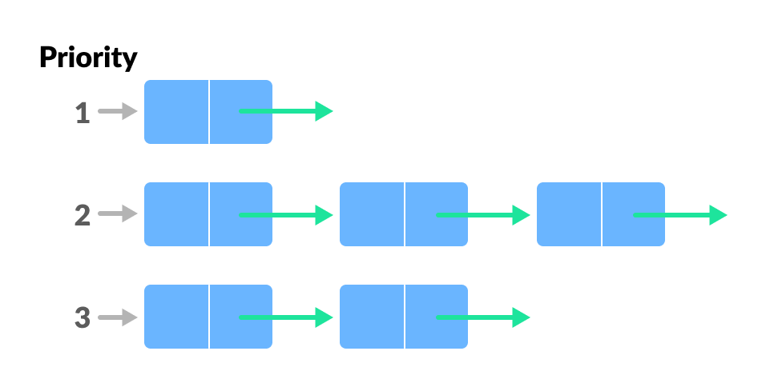
Priority Queue
A priority queue is a special type of queue in which each element is associated with a priority value.
However, if elements with the same priority occur, they are served according to their order in the queue.
Insertion occurs based on the arrival of the values and removal occurs based on priority.

Slide 96
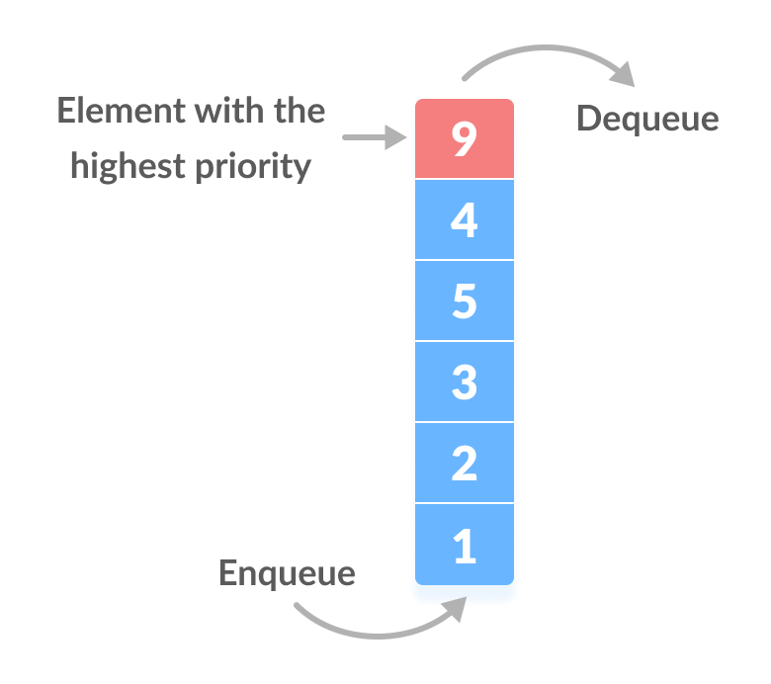
Assigning Priority Value
Generally, the value of the element itself is considered for assigning the priority. For example,
The element with the highest value is considered the highest priority element. However, in other cases, we can assume the element with the lowest value as the highest priority element.
We can also set priorities according to our needs.

Slide 97
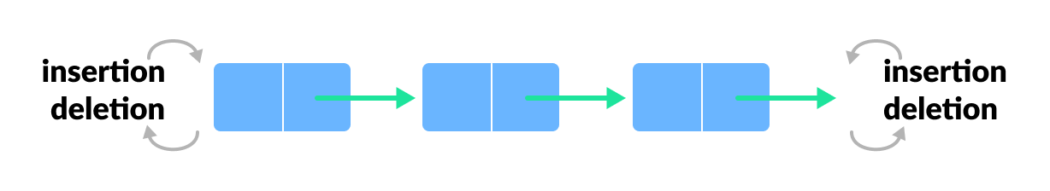
Deque (Double Ended Queue)
In a double ended queue, insertion and removal of elements can be performed from either from the front or rear. Thus, it does not follow the FIFO (First In First Out) rule.

Slide 98
Palindrome using Deque
AddFront()
RemoveFront()
AddRear()
RemoveRear()
How will you solve using Deque?

Slide 99
Recap of the Lecture
Queues can be implemented with either a linked list (with tail pointer) or an array.
Each queue operation is O(1): Enqueue, Dequeue, Empty.

